Slide 1

Machine Learning Project Presentation
Presented by Group 4
Sashanth A Mogre, Orchid Chetia Phukan, D Bharath
Eric Tom Bosco Melit, Harshal Rajesh

Slide 2

objective
Analyzing the effects of various factors on the mileage of a vehicle.

Slide 3
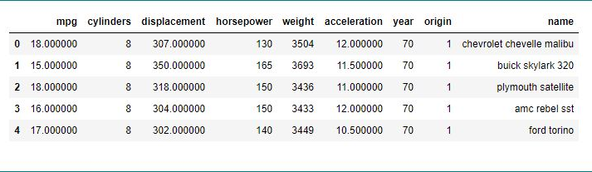
Dataset

Slide 4
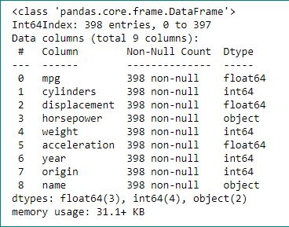
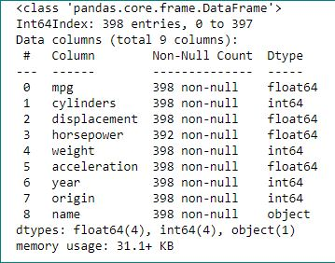
Datatypes

Slide 5
Steps followed
Step 1: Data Cleaning
Step 2: EDA
Step 3: Finding significant features and running the full model
Step 4: PCA (if required, to fix multicollinearity)
Step 5: K-Fold Cross Validation
Step 6: Grid Search CV
Step 7: Build models using different types of regressions
Step 8: Evaluating models
Step 9: Selecting the best model
Step 10: Prediction

Slide 6
Regression models used
Multiple Linear Regression
Ridge Regression
Lasso Regression

Slide 7
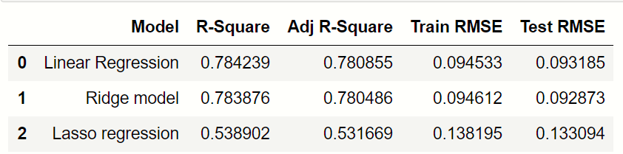
Results of regression models
Because of Lowest Test RMSE we conclude that Ridge Regression is the Best Model

Slide 8

THANK YOU

